Slide 1
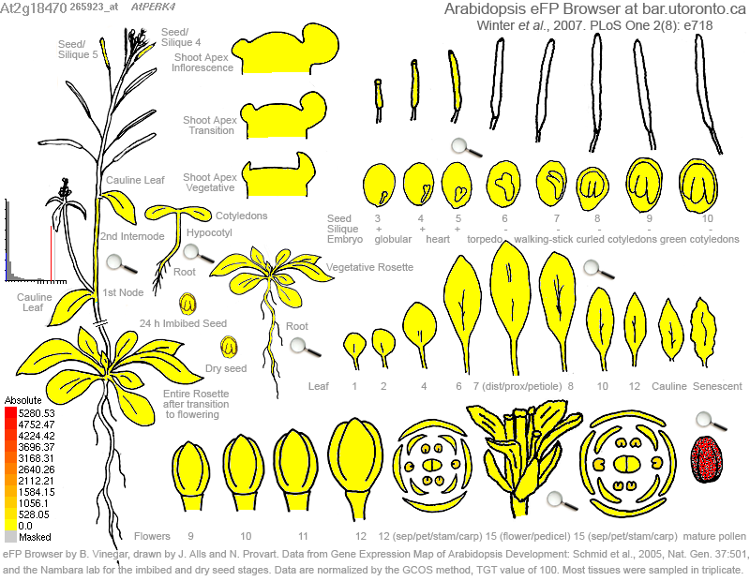

At2G18470 (PERK4)

Slide 2


At4G33970 (PEX4)

Slide 3
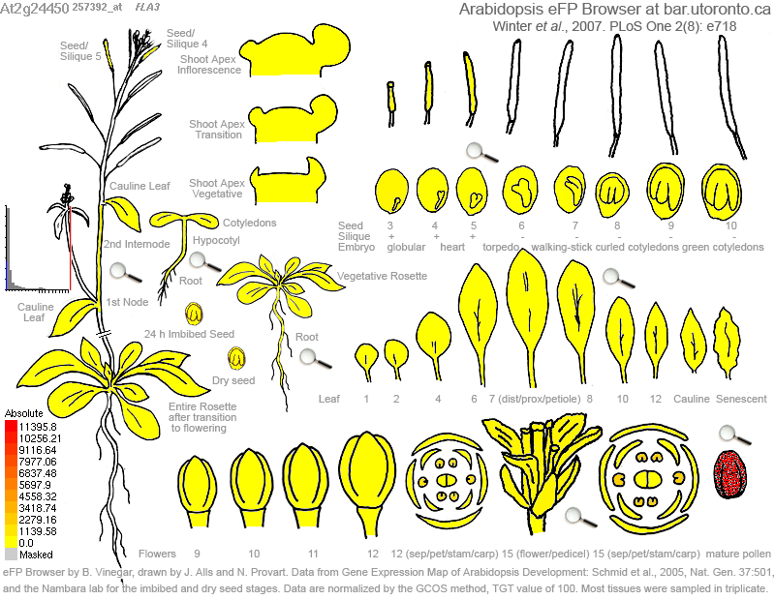

At2G24450 (FLA3)

Slide 4


At4G34440 (PERK5)

Slide 5
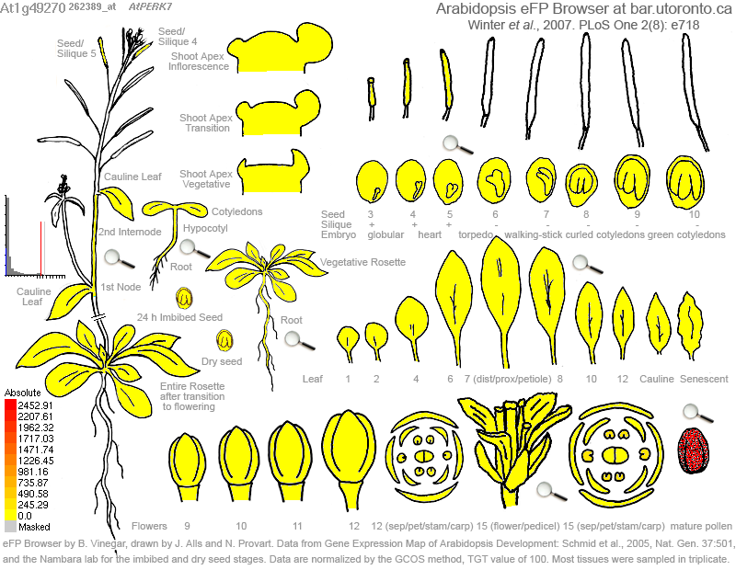

At1G49270 (PERK7)

Slide 6
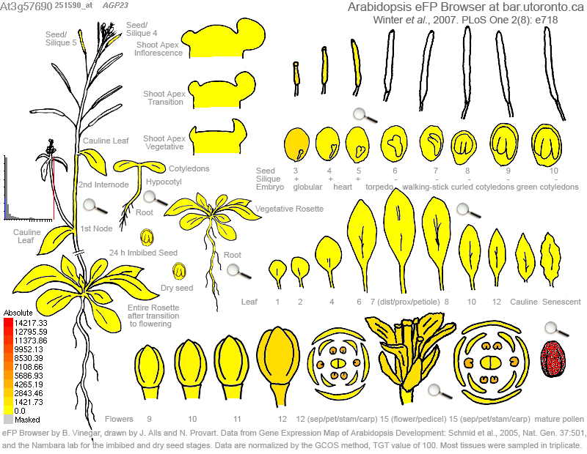

AT3G57690 (AGP23)

Slide 7


At1G23540 (PERK12)

Slide 8


At3G18810 (PERK6)

Slide 9


At1G10620 (PERK11)

